Slide 1
English Business 2 STIE NOBEL
WEEK 4
Answering the phone

Slide 2
Answer the phone the way you would like to be answered
The phone rings, let it ring twice to give a few seconds to get ready to answer, in case you were busy with something and then pick up the phone;
You announce the place where you work, say your name and ask in how you can be useful to them. The "welcoming sentence" should be something like this "Good morning, this is Company X office, it's Joan speaking, how may I help you?", just for an example;

Slide 3
Then you listen to the callers need and if you can help him/her, do so directly in a preferably short, clear and simple way;
If you can't help that person directly and you need to transfer the call to someone else, say to the caller that he/she needs to speak with another section, office, etc., and that you are going to transfer the call right away;

Slide 4
When you're going to transfer the call to another person, warn first who the caller is and the purpose of the call, and if accepted, transfer the call;
When the purpose of the caller has been achieved, thank him for using your company, office, etc., services, if that's the case, and then say good bye.

Slide 5
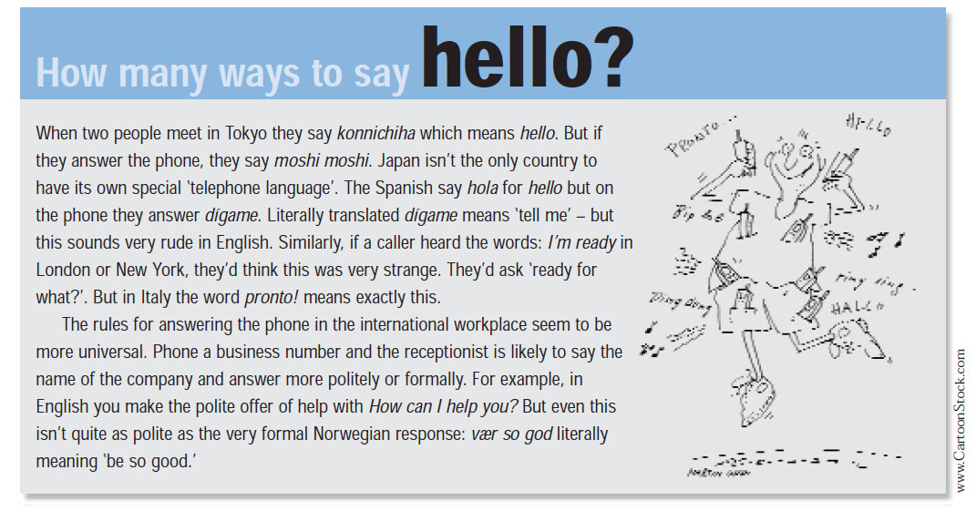
Read the article…

Slide 6
Are these statements true (T) or false (F)?
Many nationalities greet people differently on the phone than they do face-to-face. T / F
The Spanish are impolite. T / F
When an Italian meets you in the street he greets you with the words ‘I’m ready’. T / F
At work, different nationalities use a similar approach to answering the phone. T / F

Slide 7
Note: we say telephone numbers in groups of two or groups of three. For 0 say zero or oh. For 22 we can also say double two.
0708 567 8493
0770 336 3309
00 44 207 657 7467
00 39 050 364 478
010 350 114 5794

Slide 8
Write these phone numbers in the table and say them in English.
your home number
your work/campus number
your mobile
a colleague’s/friend’s number

Slide 9
Read 1–3. What do you say?
Ask to speak to Ambo Tuo.
Greet Ambo and say your name.
Say how you are.

